Slide 1
Analytics based on Govt. Land Information System (GLIS) Data
PSCS Capstone Project
VIVA - VOCE
Batch Number:
Student Name | Roll Number
Under the Supervision of,
Professor
School of Computer Science and Engineering
Presidency University
Name of the Program: B.Tech
Name of the HoD: Dr.Zafar Ali Khan
Name of the School Project Coordinators: Dr. Sampath A K / Dr. Abdul Khadar A / Mr. Md Ziaur Rahman

Slide 2
Introduction of our Project
The Government Land Information System (GLIS) is a comprehensive geospatial data repository containing valuable insights on land resources, ownership, boundaries, and land use. While this data has immense potential, utilizing it effectively for decision-making remains a challenge. This hackathon aims to encourage participants to develop innovative analytics solutions that transform GLIS data into actionable insights. By leveraging data analytics, machine learning, and geospatial analysis, participants will create solutions that optimize resource allocation, improve governance, and support sustainable development.
The hackathon focuses on key domains, including urban planning, infrastructure development, environmental conservation, land management, and socio-economic analysis. Solutions may help urban planners with zoning and mobility, identify optimal locations for infrastructure projects, monitor ecological impact.

Slide 3
Literature Review
“Smart cities: Advances in research—An information systems perspective”
Author : Elvira Ismagilova, Laurie Hughes, Yogesh K. Dwivedi, K. Ravi Raman
Description : This paper reviews the concept of smart cities from an information systems perspective, analyzing key themes such as smart mobility, smart living, smart environment, smart governance, and their alignment with the UN Sustainable Development Goals.

Slide 4
Literature Review
“GIS Based Land Information System for CMR Group of Institutions”
Author : T. Saikumar, Shaik Irfan, Dr. A. Raji Reddy, Dr. M. S. Reddy
Description: This research focuses on developing a land information system for CMR Group of Institutions using open-source Geographic Information System (GIS) technology. The study highlights the benefits of GIS in land valuation, remote sensing, data management, and multi-user access to structured databases.

Slide 5
Literature Review
“A Mobility Analytical Framework for Big Mobile Data in Densely Populated Areas”
Author :Yuanyuan Qiao, Yihang Cheng, Jie Yang, Jiajia Liu, Nei Kato
Description: This paper introduces a mobility analytical framework for processing big mobile data in urban environments. It presents methods for collecting, analyzing, and visualizing large-scale mobile data from 2G/3G/4G networks to study human mobility patterns, urban planning, and traffic management.

Slide 6
Research Gaps Identified
Inaccurate Mobility Predictions for Irregular Users – Existing models fail to predict movement for users with random mobility patterns.
Challenges in Integrating Data-Driven and Theory-Driven Approaches – Differences in foundational assumptions hinder effective research integration.
Ineffective Implementation of Digital Competence Programs – Uneven adoption and unclear learning outcomes lead to educational disparities.

Slide 7
Proposed Methodology
The methodology begins with data acquisition and preprocessing, integrating geospatial data from GLIS and external sources while cleaning and formatting it for analysis. Next, exploratory data analysis (EDA) and visualization are performed using statistical and GIS-based techniques like heatmaps and 3D models to identify key patterns.
In the model development phase, machine learning and spatial analysis techniques are applied to predict land use changes, infrastructure needs, and environmental risks, while optimization models enhance urban planning and resource allocation. A decision support system (DSS) is then developed, providing interactive dashboards and real-time geospatial analytics for informed decision-making.

Slide 8
Objectives
Optimize Land Use Planning and Urban Development: Utilize GLIS data to develop analytics tools that aid in informed decision-making for land zoning, urban expansion, and resource allocation, ensuring sustainable city growth.
Enhance Infrastructure Development Strategies: optimal locations for infrastructure projects such as roads, bridges, and power plants by analyzing environmental, demographic, and accessibility factors.
Promote Environmental Conservation and Risk Assessment: Develop geospatial models to monitor and manage natural resources, detect ecological risks, and support conservation efforts for sustainable land use.

Slide 9
Methodology/Modules
Data Collection & Preprocessing: Gather social media data, clean it by removing noise, and store it for analysis.
Feature Extraction & Model Training: Convert text into numerical form and train machine learning models for sentiment classification.
Evaluation & Prediction: Validate model accuracy and optimize predictions for better sentiment analysis.
Visualization & Insights: Display sentiment trends using dashboards and reports for actionable insights.

Slide 10
System design and Implementation
Frontend & Backend: Developed using Next.js for UI and Node.js with Express.js for API communication.
Machine Learning Model: Implements Naïve Bayes, SVM, or LSTM for sentiment classification with TF-IDF & word embeddings.
Data Processing & Analysis: Collects, cleans, and transforms social media data for sentiment prediction.
Visualization & Reporting: Displays sentiment trends through interactive dashboards, charts, and reports for insights.

Slide 11
Architecture
Data Layer: Collects and preprocesses social media data, removing noise, stopwords, and special characters to ensure clean input.
Machine Learning Layer: Uses TF-IDF, word embeddings, and ML models (Naïve Bayes, SVM, LSTM) to classify sentiment as positive, negative, or neutral.
Backend Layer: Built with Django REST Framework, it processes requests, manages data flow, and interacts with ML models for real-time predictions.
Visualization Layer: Displays sentiment analysis results through interactive dashboards, charts, and reports for decision-making.

Slide 12
Hardware/software components
Hardware Requirements
Processor: Intel i5/i7 (or equivalent) with at least 2.5 GHz clock speed.
RAM: Minimum 8GB (Recommended 16GB for large-scale processing).
Storage: At least 256GB SSD (Recommended 512GB+ for handling datasets).
GPU (Optional): NVIDIA GPU for deep learning-based sentiment analysis.
Internet Connection: Required for API integration and cloud-based deployments.

Slide 13
Hardware/software components
OS: Windows 10/11, macOS, or Linux (Ubuntu recommended).
Languages & Frameworks: Python 3.8+ (Django for backend), JavaScript (Next.js for frontend).
Database: PostgreSQL or MySQL for structured data storage.
ML Libraries: Scikit-learn, TensorFlow/Keras, NLTK for sentiment analysis.
Visualization: Matplotlib, Seaborn, Chart.js for graphical insights.
Cloud Services (Optional): AWS, Azure, or Google Cloud for scalable deployment.

Slide 14
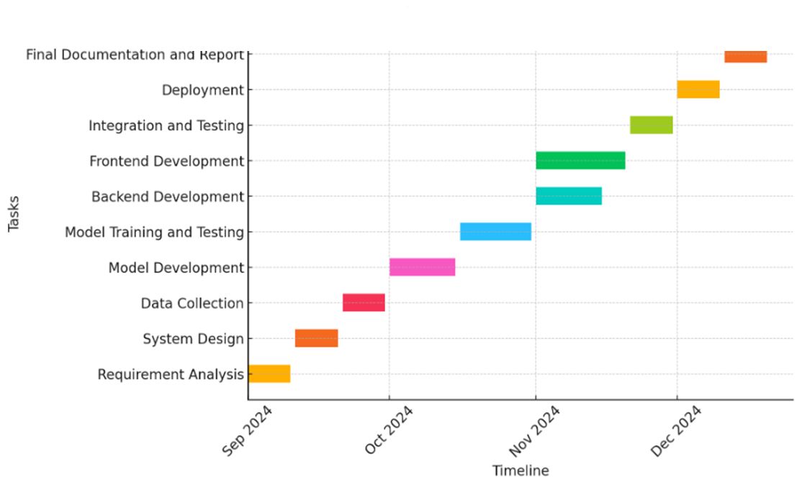
Timeline of Project

Slide 15
Expected Outcomes
Accurate Sentiment Analysis: Achieves high precision in classifying social media sentiment as positive, negative, or neutral using ML models.
Automated Data Processing: Streamlines data collection, cleaning, and preprocessing, reducing manual effort and improving efficiency.
Real-Time Insights & Visualization: Provides interactive dashboards, charts, and reports to help users understand sentiment trends.
Scalable & Efficient System: Supports large-scale data analysis with cloud-based deployment for faster processing and accessibility.
User-Friendly Interface: Simplifies sentiment analysis for non-technical users through an intuitive web-based platform.

Slide 16
Conclusion
The sentiment analysis system effectively classifies social media sentiment into positive, negative, or neutral, providing real-time insights for businesses, researchers, and analysts. By leveraging machine learning models and automated data processing, the platform ensures high accuracy and efficiency. The user-friendly web interface allows non-technical users to easily access and interpret sentiment trends through interactive dashboards and visualizations.
With scalability and cloud-based deployment, the system can handle large datasets, making it suitable for diverse applications such as market research, brand monitoring, and public opinion analysis.

Slide 17
References
Liu, B. (2020). Sentiment Analysis: Mining Opinions, Sentiments, and Emotions. Cambridge University Press.
Pang, B., & Lee, L. (2008). Opinion Mining and Sentiment Analysis. Foundations and Trends in Information Retrieval, 2(1-2), 1-135.
Medhat, W., Hassan, A., & Korashy, H. (2014). Sentiment Analysis Algorithms and Applications: A Survey. Ain Shams Engineering Journal, 5(4), 1093-1113.
Cambria, E., Schuller, B., Xia, Y., & Havasi, C. (2013). New Avenues in Opinion Mining and Sentiment Analysis. IEEE Intelligent Systems, 28(2), 15-21.

Slide 18
Publication Details

Slide 19

Thank You

